Slide 1
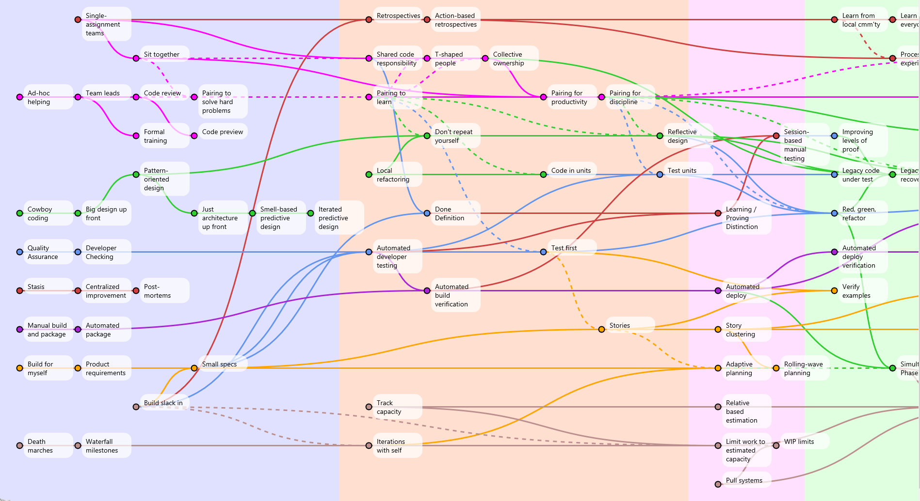
Adopting Agile via Continuous Improvement
Your first 5 days and 2 years
Arlo Belshee
@arlobelshee, http://arlobelshee.com/
http://arlobelshee.github.io/AgileEngineeringFluency/Stages_of_practice_map.html

Slide 2

Why bother?

Slide 3
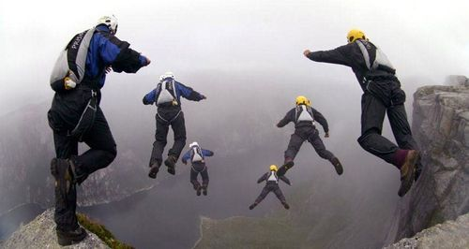
Why listen to me?

Slide 4

First reduce risk, then leverage low-risk

Slide 5
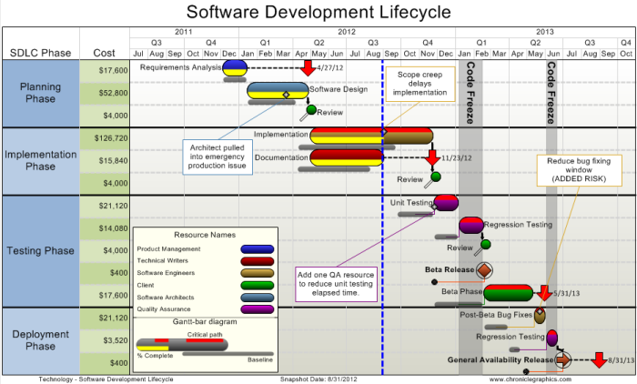
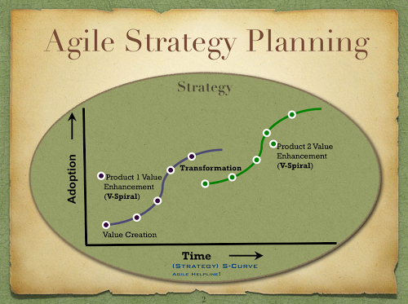
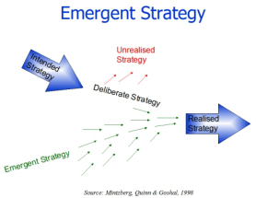
Planning is irrelevant and political

Slide 6

But what if we build the wrong thing?
Notes:
1/3 features are useful. Some very useful. The very harmful ones get removed in beta. Regression to mean means your product will have some value.
But only 1/3 of projects finish in required time and scope. Odds are you will be late to market and missing some of the things you need.

Slide 7
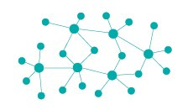
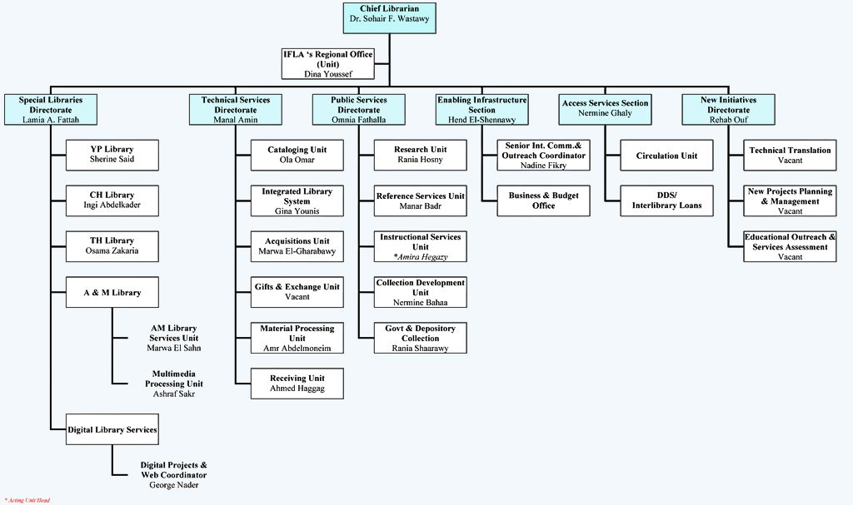
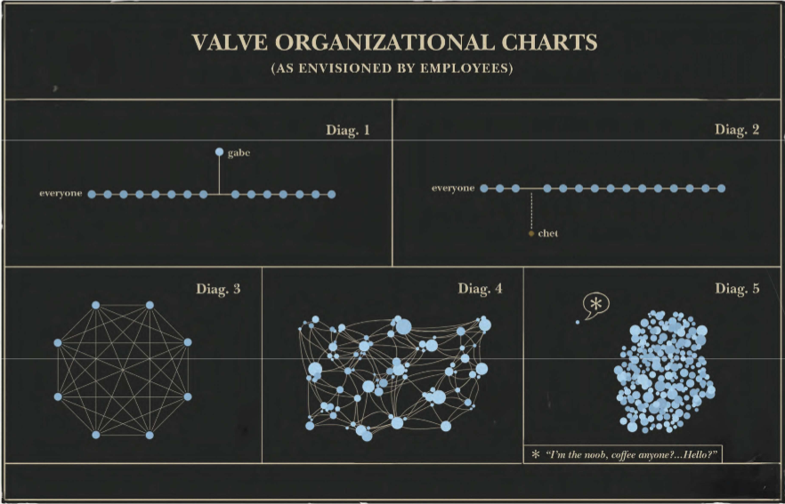
One required pain: decentralization

Slide 8
Agile transformation recipe
Aligned TEAMS
Drive out risk
Real customer involvement
Culture of sustained change (company-wide)
This is “Your Path Through Agile Fluency” restated
http://agilefluency.com/ (James Shore and Diana Larsen)
Start with 1 + 2, then add

Slide 9

Fluency, not proficiency

Slide 10
Degrees of fluency?
Re-label existing practices
When coach is helping
When I have seen a situation like this before
New situations
Under stress

Slide 11
The source of all risk
Predictable
Random
Plan, Code
Stabilize
Make a mess
Clean it up
16%
84%

Slide 12
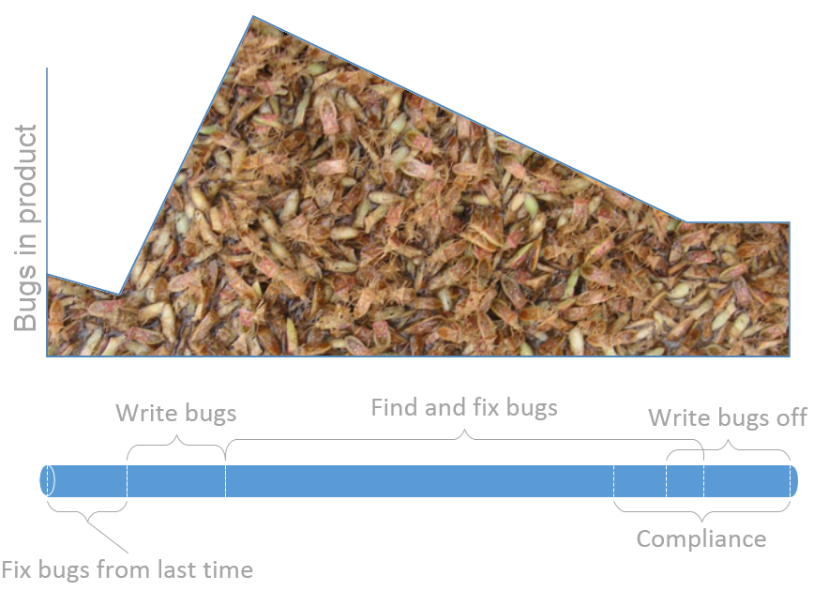
The source of stabilization

Slide 13
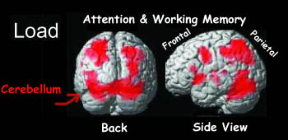
The source of all bugs
Notes:
Humans
Cognitive load
Complexity, illegibility, size

Slide 14
Chunking & Learning
Concrete Experience
Reflective Observation
Abstract Concept
Active Experiment

Slide 15
Behaviors
Work Outputs
Business Results
Work together
Learn constantly
Work tiny
Prove it
Get done
Risk first
Value questioning
System
Team-oriented development
Low risk / cost to change teams and code
Change based on data
Inspect and adapt faster
Decide based on data and experiments
Refactoring
Experiments with measures

Slide 16
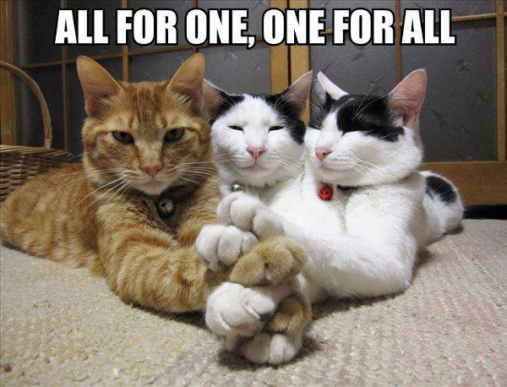
Real first chunk: make a team

Slide 17
Change happens side-in
Safety, culture, framing
Behavior changes
Cost, incidental risks, data, knowledge, decisions

Slide 18
Doer (everyone)
Does all the things.
Doing, assessing, and deciding.
Owns the transition & its outcome.
Champion
Brings important idea(s) to team.
Assesses skills.
Instructs or coaches.
Coach
Facilitates teaming.
Helps people adapt to change.
Servant leader
Provides safety to experiment.
Supports culture of continuous change.
Work self
out of job
Gurus / Community
Provide experience and alternatives.
Prevent best practice thinking.
Notes:
Non-roles: scrummaster, product owner, manager.
Collaboration -> if something is important, assign it to team. Use individual accountability for unimportant scut work.

Slide 19

First chunk: make a change without a bug

Slide 20
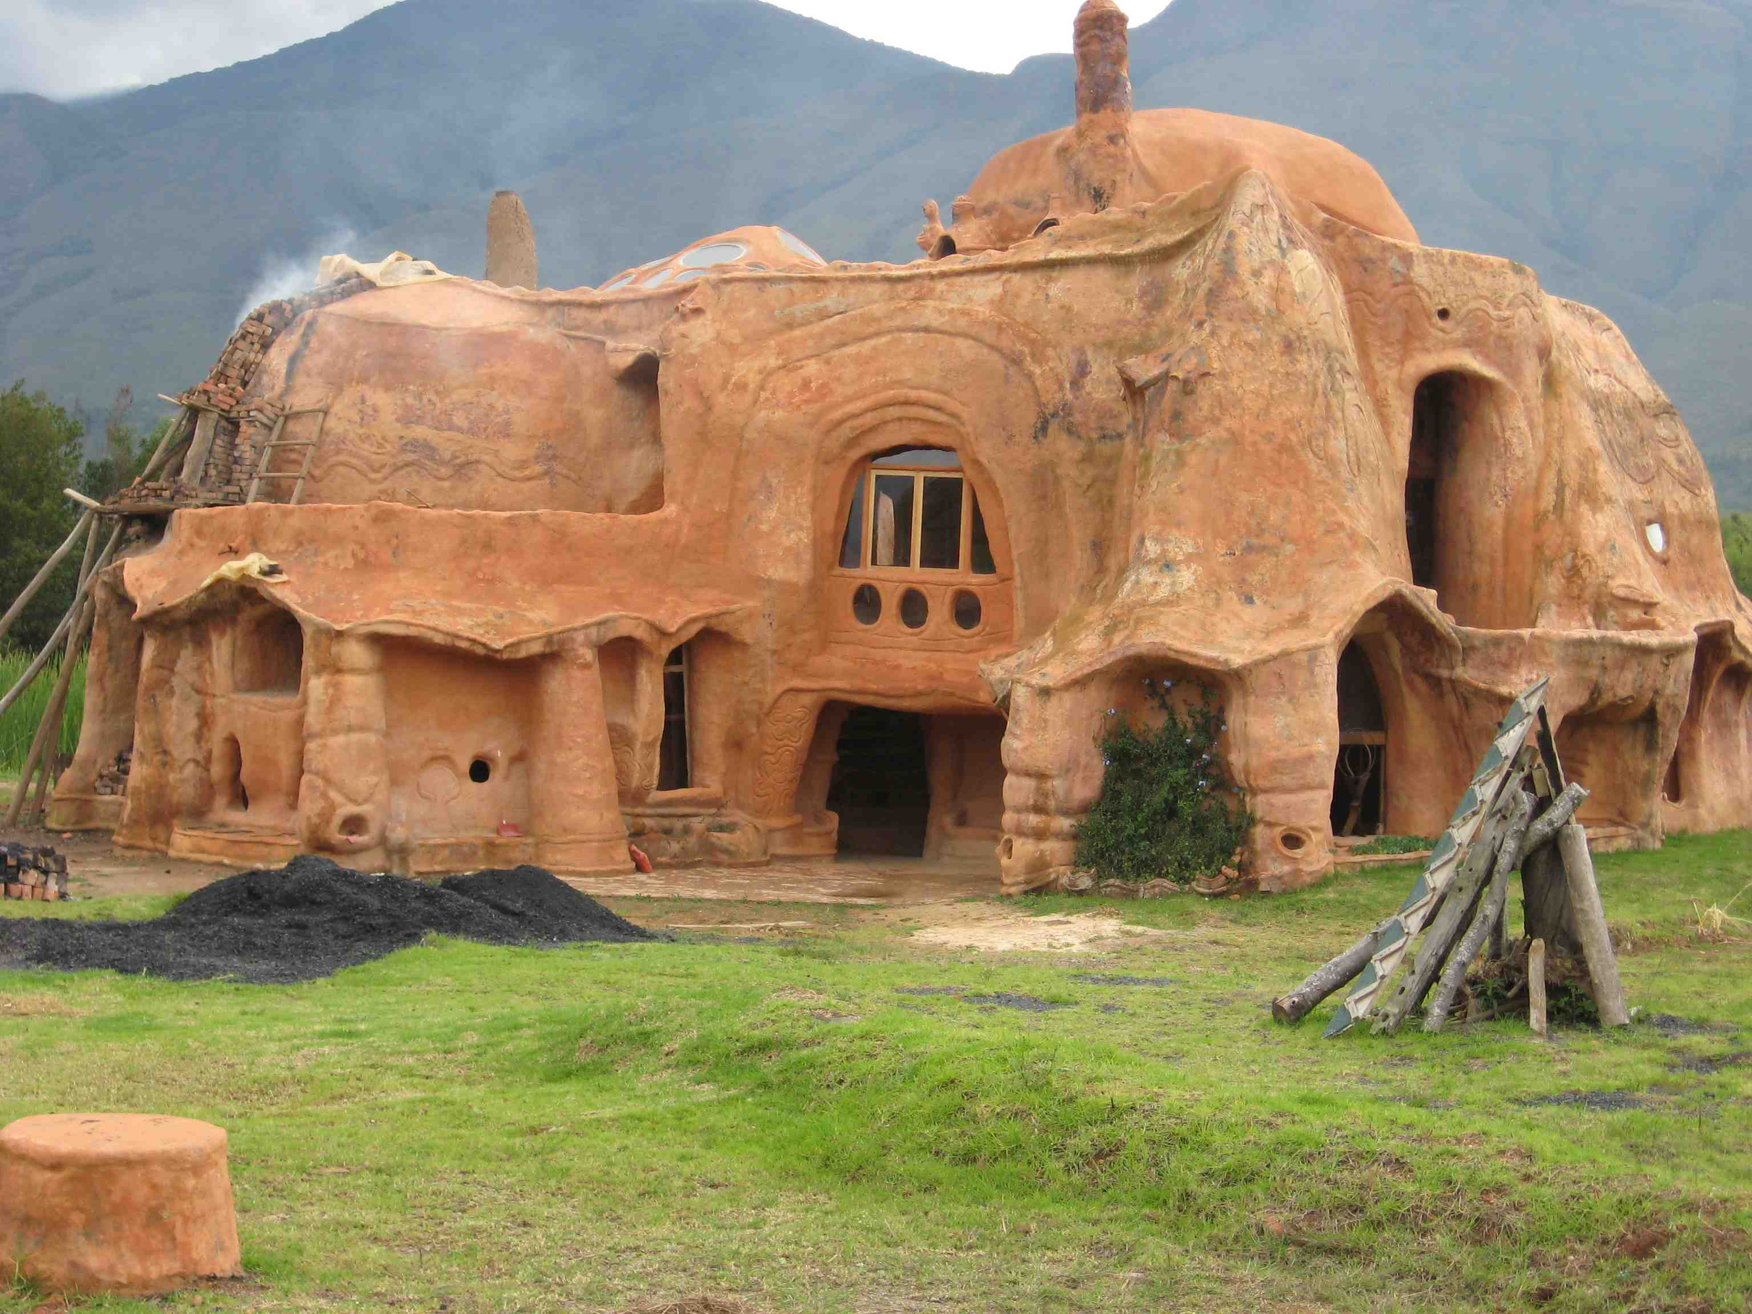
Refactor all the things

Slide 21

First team goal: own your destiny
Notes:
Vision is bottom-up. At least, it is if you want the vision to be informed by reality.
Envisioning is easier the further you are from reality. Just not as useful.

Slide 22

First product goal: great names

Slide 23

Chunking & early value
Notes:
Even early levels of proficiency deliver real value. Get that value!

Slide 24
Initial practices (well, mostly)
Local Refactoring (refactoring 1)
Test as spec (testing 2)
test first if greenfield; wrap legacy if brownfield
Whole team assignments (work together 1)
Shared work (work together 2
Pair to learn (work together 3)
Action-oriented retrospectives (own your destiny 4)
Vertical decomposition (define work 1)

Slide 25
The next 2 years
http://arlobelshee.github.io/AgileEngineeringFluency/Stages_of_practice_map.html

Slide 26
One possible path
Preparing for the Transition
2
months
6
months
18
months
OWN YOUR DESTINY
LEARN CONSTANTLY
DISCIPLINE IS FREEDOM
Culture
WORK TINY
STOP DIGGING DEEPER
NEW CODE IS BUG FREE
CHANGE LEGACY CODE WITHOUT BUGS
PAY OFF CODE DEBT
CONTINUOUS DELIVERY
Execution
Product Strategy & Planning
LIMIT WORK TO CAPACITY
STATUS BY PROGRESS
LONG-RANGE PREDICTABILITY
TEST IN PRODUCTION

Slide 27
TL;DR
Experimentation is limited by risk
Risk is determined by errors
Errors are caused by working too hard
So make one simple change
And do it fluently
Then do that again. And again. For a couple decades or so.

Slide 28
Adopting Agile via Continuous Improvement
Your first 5 days and 2 years
Arlo Belshee
@arlobelshee, http://arlobelshee.com/
http://arlobelshee.github.io/AgileEngineeringFluency/Stages_of_practice_map.html

